Slide 1

Customer Churn Prediction System
Subscription-Based Services · Behavioral Analytics · Machine Learning
ACADEMIC PROJECT PRESENTATION
P.LAKSHMI
REG NO : 323129510042

Slide 2

The Retention Crisis in Subscription Business
Reactive Strategies
Traditional retention responds only after customers leave — too late to recover lost revenue.
Manual Analysis
Human-led behavior analysis cannot scale to millions of customers or detect subtle churn signals.
Delayed Detection
At-risk customers go unidentified until they cancel, eliminating any window for intervention.
Revenue Erosion
Customer attrition silently compounds, eroding recurring revenue and lifetime value over time.

Slide 3
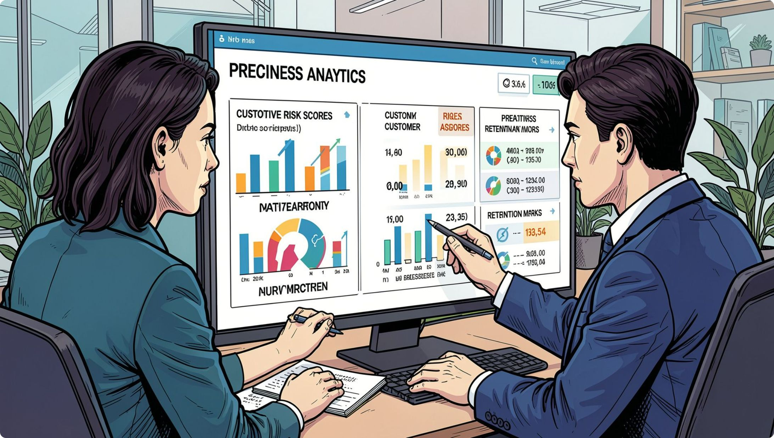
Why Accurate Churn Prediction Is Essential
Churn prediction transforms raw customer data into actionable foresight — enabling teams to intervene before attrition occurs.
Proactive Intervention
Targeted Retention
Revenue Protection
Identify at-risk customers weeks before they cancel.
Deploy personalized offers to high-value, high-risk segments.
Reduce involuntary churn and protect recurring revenue streams.

Slide 4
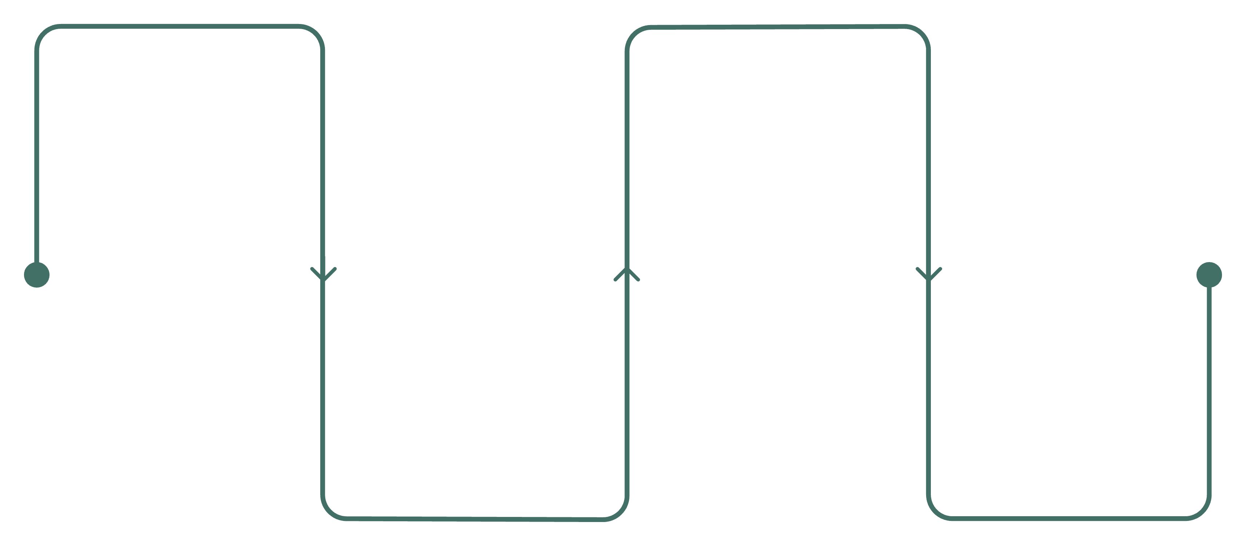
System Architecture Overview
Data Collection
ML Prediction
Customer demographics, logs, payments, complaints
Classification models and churn scoring
Decision Support
Preprocessing
Segmentation, dashboards, retention recommendations
Normalization, encoding, feature extraction
The system integrates behavioral data from multiple touchpoints into a unified ML pipeline — delivering churn probability scores and retention recommendations through a secure web-based administration interface.

Slide 5
Core Technologies & Concepts
ML Classification
Behavioral Analytics
Logistic regression, random forest, and gradient boosting classify customers as churners or retainers.
Usage frequency, session duration, and engagement patterns reveal early attrition signals.
Data Preprocessing
Feature Engineering
Missing value imputation, outlier handling, and normalization prepare raw data for modeling.
Derived features — recency, frequency, payment delinquency — amplify predictive signal.
Customer Segmentation
Data Visualization
Clustering groups customers by behavior and risk profile for targeted retention.
Interactive dashboards translate model outputs into business-ready insights.

Slide 6
Key Platform Features
Customer Data Management
1
Centralized repository for demographics, subscription history, usage logs, and complaint records.
Predictive Model Training
2
Automated training, cross-validation, and performance evaluation with configurable thresholds.
Churn Probability Scoring
3
Every customer receives a real-time churn score, ranked and filterable by risk tier.
Retention Strategy Engine
4
AI-recommended interventions — discounts, outreach, or plan upgrades — matched to segment profiles.
Analytical Dashboards
5
Reports on churn trends, model performance, campaign ROI, and customer behavior patterns.

Slide 7
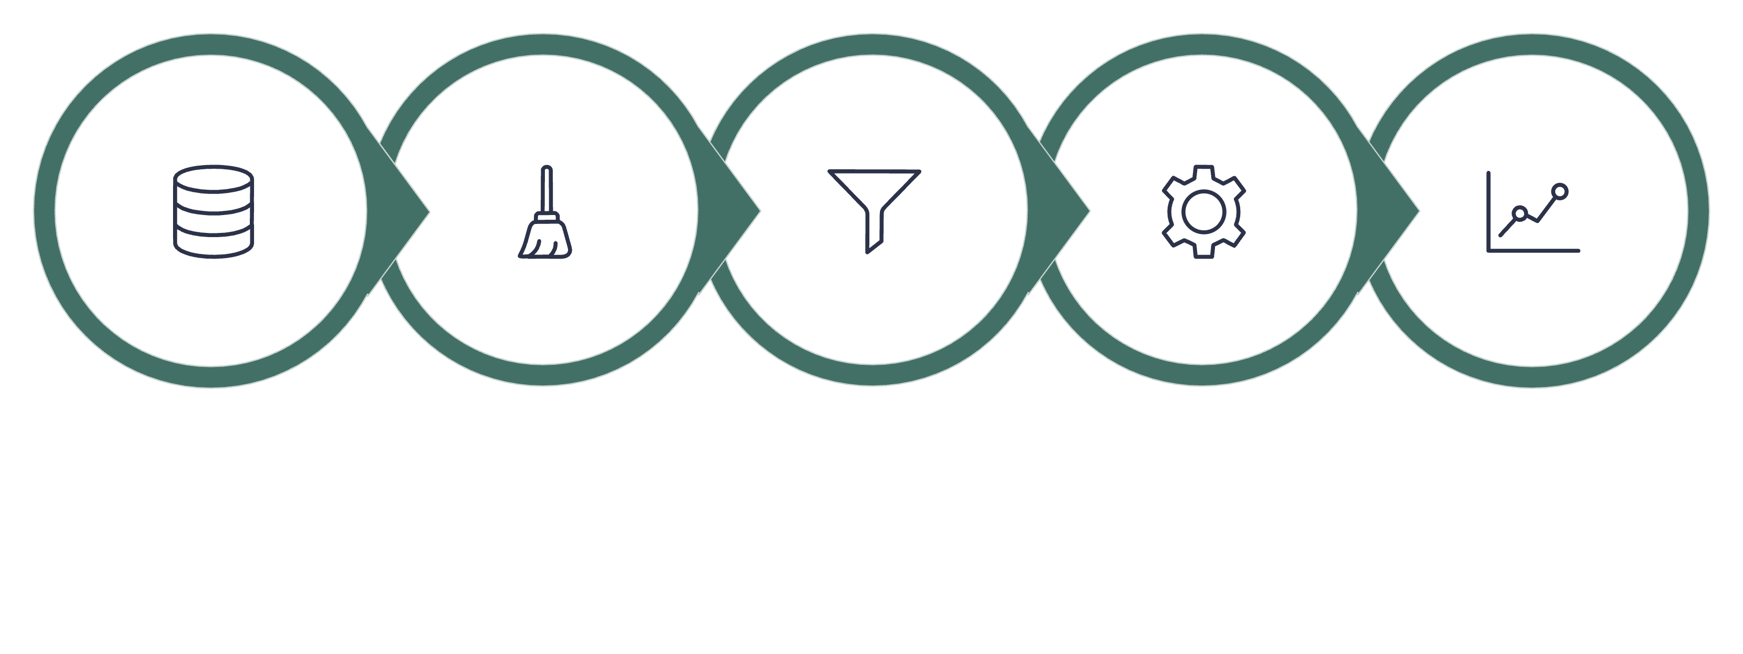
Implementation Methodology
Data Collection
Feature Selection
Prediction & Scoring
Preprocessing
Model Training
The end-to-end pipeline ensures data quality at each stage — from raw ingestion through model deployment — with rigorous evaluation metrics validating performance before production use.
Scalability & Security
Interpretability
Designed to handle millions of records across industries with role-based access control and encrypted data storage.
Feature importance scores and SHAP values explain predictions, building trust with business stakeholders.

Slide 8
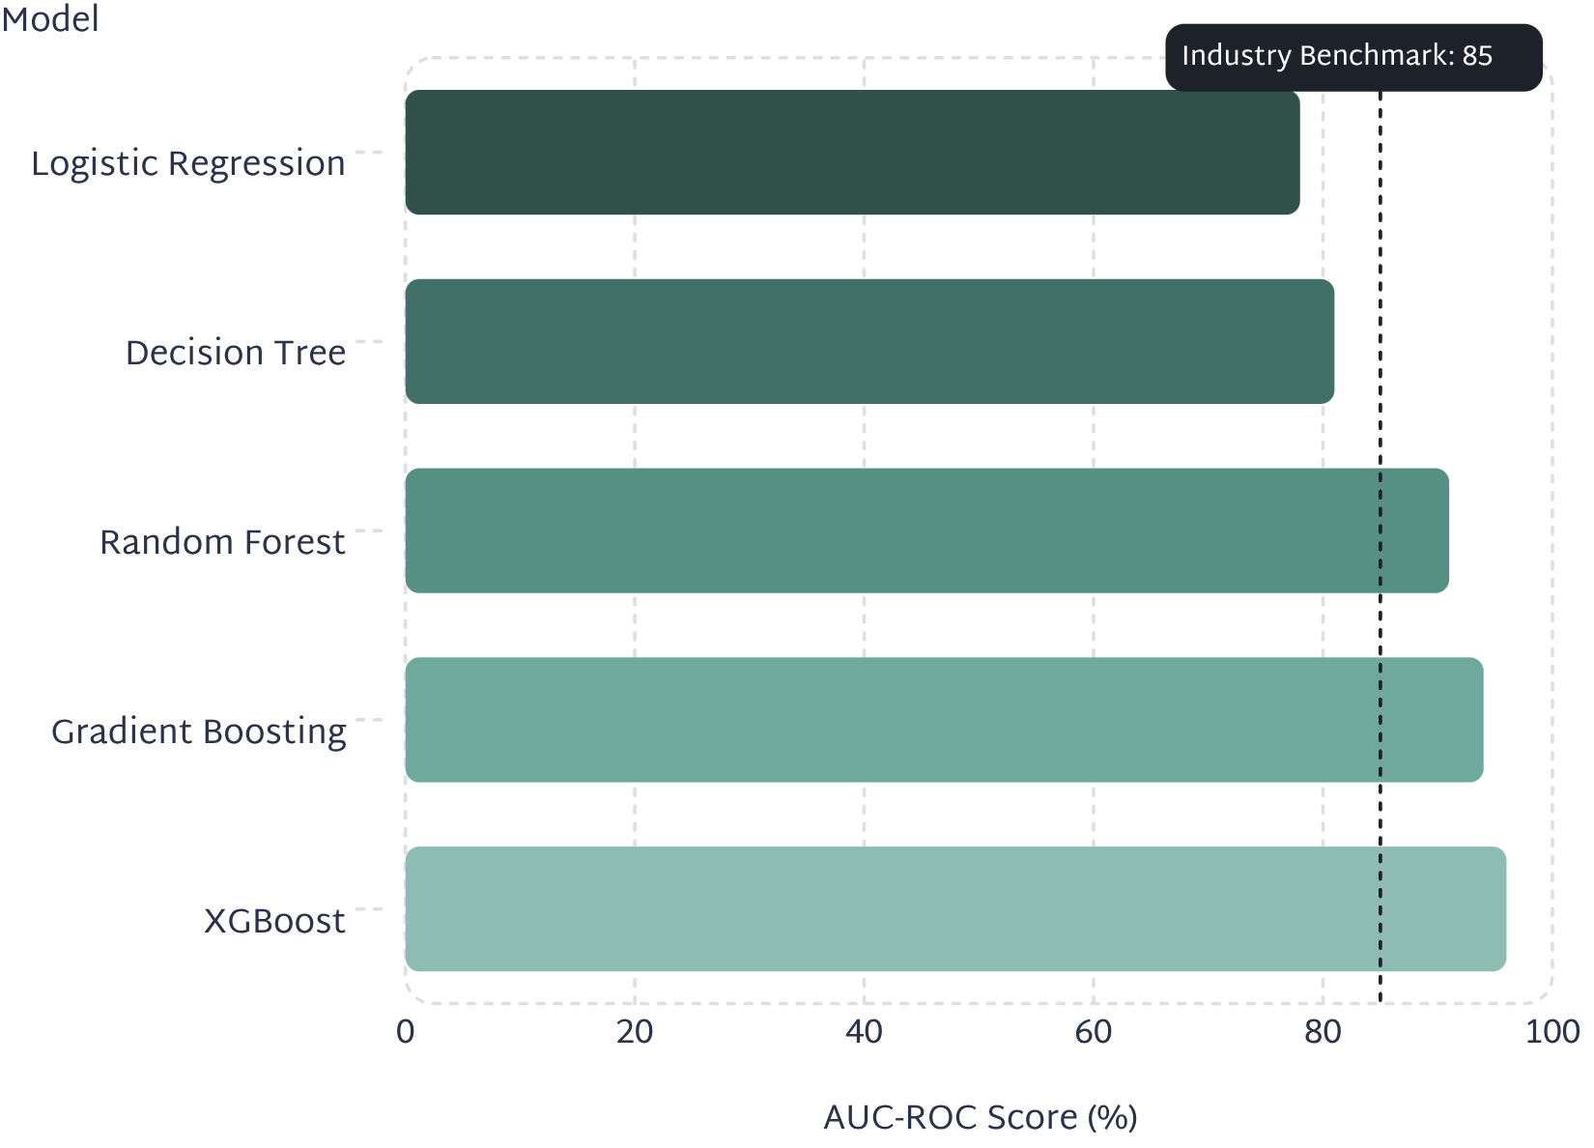
Model Performance & Evaluation
Why Gradient Boosting Leads
Ensemble methods like XGBoost consistently outperform single-model approaches by combining multiple weak learners, reducing overfitting, and capturing complex non-linear patterns in customer behavior data.
Precision: 93%
Recall: 89%
F1-Score: 91%
Few false positives — retention resources focus on truly at-risk customers.
High capture rate of actual churners before they cancel.
Balanced precision and recall across diverse customer segments.

Slide 9
Business Benefits Delivered
Improved Prediction Accuracy
Proactive Retention
Reduced Revenue Loss
ML models outperform rule-based heuristics in identifying at-risk customers.
Intervene before cancellation — not after — with timely, targeted outreach.
Protect recurring revenue by retaining high-value customers before they leave.
Optimized Campaigns
Increased Customer LTV
Focus marketing spend on segments with the highest retention ROI.
Longer retention cycles directly increase lifetime value and profitability.

Slide 10

The Road Ahead: Future Enhancements
The system's architecture supports continuous evolution — from deeper models to real-time intelligence and enterprise integrations.
01
02
Deep Learning Models
Real-Time Analytics
Neural networks to capture complex temporal behavior patterns.
Streaming predictions triggered by live customer events.
03
04
Explainable AI
CRM & Marketing Integration
Transparent, interpretable predictions for stakeholder trust.
Native connectors for Salesforce, HubSpot, and automation platforms.
05
06
Cloud & Mobile Deployment
Sentiment Analysis
Scalable cloud infrastructure with mobile analytics access.
NLP-driven feedback analysis to enrich churn signals.

